Slide 1
Chapter 2 Computer Networks: The Hardware
BIS416E – Networks & Security
Dr. Omayma Younis

Slide 2
Learning Objectives
Determine the hardware components for installing a computer network.
Explain the function of the Network Interface Card.
Understand the different properties of the cables used in networking.
Determine the functionality of each of the network connectivity devices.

Slide 3
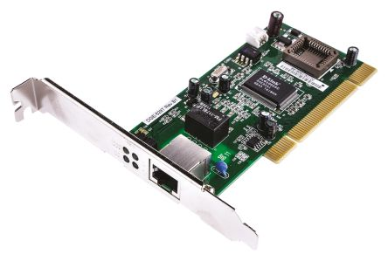
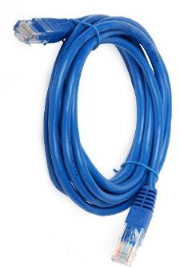
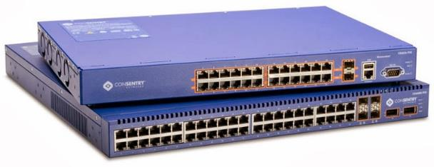
Network Hardware Components
To physically install a network, the following basic hardware is needed:
I. Network Interface Card
II. Cables/Links
III. Network Connectivity Devices

Slide 4
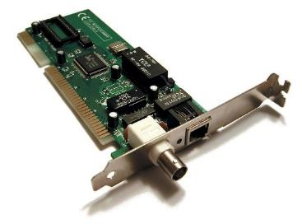

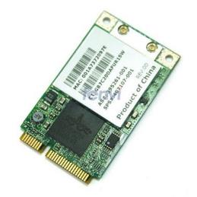
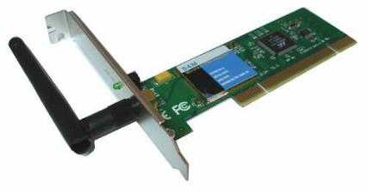
I. Network Interface Card (NIC)
The NIC is the principal hardware device that differentiates between a networked computer and a stand-alone computer.
Every device in a network must contain at least one NIC which provides the physical interface between computer and cabling. It’s also rare to find a laptop today without a built-in wireless network card.
NIC with both, BNC & RJ-45 ports
NIC with RJ-45 port (most popular)
Wireless NIC
Wireless built-in NIC (in laptops)

Slide 5
I. Network Interface Card (NIC)
It prepares data, sends data, and controls the flow of data. It can also receive and translate data into bytes for the CPU to understand.
It is the NIC’s job to translate the data from the computer into signals that can flow easily along the cable.
It does this by translating digital signals into electrical signals (and in the case of fiber-optic NICs, to optical signals).
When choosing an NIC, use one that fits the bus type of your PC. If you have more than one type of bus in your PC (for example, a combination ISA/PCI), use an NIC that fits into the fastest type (the PCI, in this case).
Let’s view our Network Card(s) on our computers from the “Device Manager”.

Slide 6
II. Cables/Links
Typically, the NICs of the networked computers are physically connected to one of the following types of cables:
Recall the different types of transmission media covered previously in Chapter 1.
Coaxial cables
Unshielded twisted-pair cables
Shielded twisted-pair cables
Fiber optic cables
Obviously, these physical cables are not connected to a wireless NIC.

Slide 7
II. Cables/Links
Network cables are distinguished with respect to:
Transmission Speed
Distance
Transmission Mode: Simplex / Half-duplex / Full-duplex
Electromagnetic Immunity (EMI)

Slide 8
II. Cables/Links
Examples:
Ethernet Name | Cable Type | Speed | Distance | Notes
10base-2 | Coaxial cable | 10Mbps | ≈ 200 m | aka: Thinnet
10base-5 | Coaxial cable | 10Mbps | ≈ 500 m | aka: Thicknet
10Base-T | UTP CAT 3,4 | 10 Mbps | 100 m
100Base-TX | UTP CAT 5, 5e, 6 | 100 Mbps | 100 m | aka: Fast Ethernet
100Base-FX | Fiber Optic | 100 Mbps | 2 km
1000Base-LX | Fiber Optic | 1000 Mbps | 2 km | Uses SC and LC connectors
10GBase-LR | Fiber Optic | 10 Gbps | 10 km
10GBase-ER | Fiber Optic | 10 Gbps | 40 km

Slide 9
III. Network Connectivity Devices
Okay - by now, you should be fairly familiar with the various types of network media and cables, so it is time to learn about some of the devices they hook-up to.
Because these devices connect network entities, they are known as connectivity devices, which include:
Repeaters
Hubs
Bridges
Switches
Routers

Slide 10
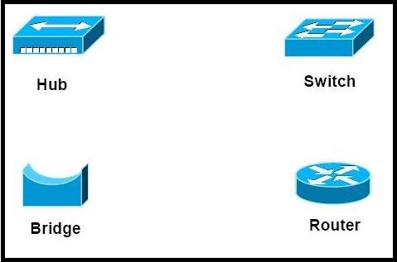
III. Network Connectivity Devices
These connectivity devices can be categorized as follows:
Layer-1 Devices
Repeaters
Layer-2 Devices
Bridges
Hubs
Layer-3 Devices
Routers
Switches

Slide 11
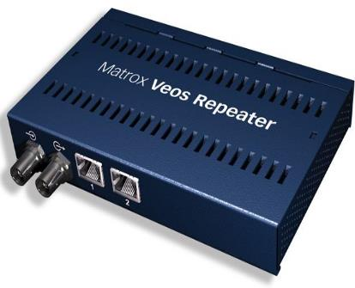
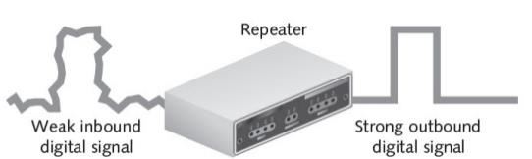
III. Connectivity Devices
A. Repeaters
One of the pitfalls of networking environments is that the electrical signal traveling through the wire is weakened over distance. This is where repeaters come in !
The repeater connects the segments of a network. If your network layout exceeds the normal specifications of the cable, you can use repeaters to allow the signal to travel the distance by placing the repeaters at different points in the network.

Slide 12
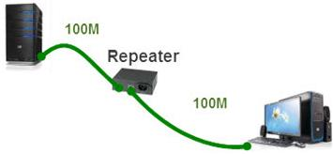
III. Connectivity Devices
A. Repeaters
Question: if you are using UTP cables, and remember that this type of cables is limited to a distance of (100m theoretically/ 80m practically) . What should you do if you want to connect two systems together that are (200m) apart.
Answer: You would place a repeater at the (100m) point, so that it will regenerate the signal allowing it to travel the extra difference.
Question: what if the nodes are 250m apart?

Slide 13
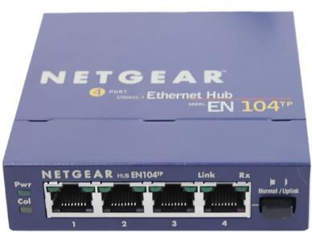
III. Connectivity Devices
B. Hubs:
As you learned earlier, a hub is a central device that connects all the nodes of the network together in a star topology network.
Physically a hub is a box with several RJ-45 ports (typically between 4 and 32 ports) that allows you to connect several devices together using twisted pair cables.
When a computer sends a piece of data to another computer, the electrical signal leaves the network card of the sending node and reaches the hub, and the hub sends the signal to all ports on the hub so that all nodes can check to see whether the data is destined for them (this process is called broadcasting).

Slide 14
III. Connectivity Devices
B. Hubs:
What if the number of devices (e.g. 20 nodes) is much more than the number of ports of the hub (e.g. 8 ports) ! … The answer is cascading hubs.
There is a switch-button on the hub to indicate that you wish to use one port to cascade (connect) to another hub (referred to as the uplink port).
So, if you wish to chain two hubs together, you simply need to switch-on the setting to use the last port as the cascade port. The uplink port connects to a normal port on the next hub.

Slide 15
III. Connectivity Devices
B. Hubs:
Classwork: If you want to construct a network composed of 20 computers, and the hub has 8 ports (including the uplink port)…
Show how many hubs of this type will you need. Sketch your network connections (show how are the nodes and hubs connected together).
What if you need to add one more extra computer to your network?

Slide 16
III. Connectivity Devices
B. Hubs:
There are two types of hubs:
Passive Hub: it simply receives data from one port of the hub and send it out to all the other ports of the hub. A passive hub contains no power source or electrical components. Regenerating the signal is a function of an active hub …
Active Hub: it has a built-in repeater. Active hubs regenerate the data before sending it to all of the destination ports on the hub. Hence, you can expand the length of your network using active hubs. Think of it this way:
Passive Hub + Repeater ≡ Active Hub

Slide 17
III. Connectivity Devices
We have discussed two of the popular layer-1 devices (i.e. repeaters & hubs), which have no connectivity intelligence.
Remember that a hub would forward the signal to all ports on the hub (i.e. broadcasting), which will lead to traffic problems as you start adding hubs to the network.
Now, let’s take a look at some popular layer-2 devices. Layer-2 devices are a little smarter than layer-1 devices in the sense that they actually can make decisions about where the electrical signal needs to go!

Slide 18
III. Connectivity Devices
C. Bridge
Bridges are devices that are used to break down (divide) one large network into multiple small connected segments.
A bridge is used to filter traffic by only forwarding traffic to the destination network segment.
It has a bridge table used in filtering decisions.
Each entry of this table contains the MAC address (physical network address) of a workstation, and the network segment at which it resides.
Bridge Table
MAC Address Segment
00-B0-D0-B1-ED-51 3
00-0D-60-48-53-9E 2
00-A0-C9-C3-D2-E2 1
Bridge
Bridge

Slide 19







III. Connectivity Devices
C. Bridge
Let’s look at an example of how a bridge filters network traffic.
When Computer A sends data to Computer F, the data will travel through the full length of segment 3.
The signal reaches the bridge, which looks at the destination MAC address of the data packet, and compares it with the MAC addresses stored in its bridging table.
Segment 3
Bridge Table
MAC Address Segment
Segment 1
Segment 2
Bridge

Slide 20
III. Connectivity Devices
C. Bridge
Since this is the first piece of data sent on the network, the MAC address for Computer F is not in the bridging table, so the bridge will need to forward the data to both segment 1 and segment 2.
When the bridge received the packet from Computer A, it stored the MAC address of Computer A as well as its network segment.
Segment 3
Bridge Table
MAC Address Segment
00-B0-D0-B1-ED-51 3
Segment 1
Segment 2
Bridge

Slide 21
III. Connectivity Devices
C. Bridge
Also note that when Computer F replies to Computer A, the data will need to pass through the bridge, so the bridge will know which network segment Computer F resides on, and will record this MAC address in the bridging table.
Over time, the bridging table will be filled with all MAC addresses and their associated network segments → So-called “Learning Bridge”
Segment 3
Bridge Table
MAC Address Segment
00-B0-D0-B1-ED-51 3
00-0D-60-48-53-9E 2
Segment 1
Segment 2
Bridge

Slide 22
III. Connectivity Devices
D. Switch
Network switches appear nearly identical to network hubs, but a switch generally contains more intelligence than a hub.
When you use a switch instead of a hub, the switch acts as a filtering device by associating the MAC address of the computer with the switch port to which the computer is connected to.
Unlike hubs, switches allow several users to send information over a network at the same time without slowing each other down.

Slide 23
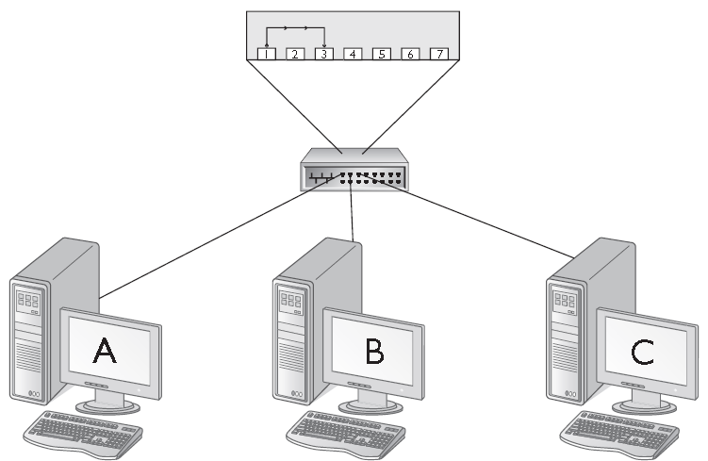
III. Connectivity Devices
D. Switch
For example, when Computer A transmits a packet to Computer C. The packet enters the switch from port 1 and then travels a direct route to port 3, because the switch uses the destination MAC address of the packet and knows that the MAC address is of the device connected into port 3.
Switch Table
MAC Address Port
00-B0-D0-B1-ED-51 1
00-0D-60-48-53-9E 2
00-A0-C9-C3-D2-E2 3

Slide 24
III. Connectivity Devices
D. Switch
From port 3, the packet is transmitted to Computer C. During this process, Computer B is unaware of the traffic between Computers A and C, because there is a direct path within the switch and no shared connection (i.e. no broadcasting).
Switch Table
MAC Address Port
00-B0-D0-B1-ED-51 1
00-0D-60-48-53-9E 2
00-A0-C9-C3-D2-E2 3

Slide 25
III. Connectivity Devices
D. Switch
It is a best practice to use switches whenever possible because of the increase in performance over a standard hub.
The bandwidth with a standard hub is shared by all users connected to the hub; however, with a switch, all users get the full network bandwidth.
For example, a 100 Mbps network with a 4-port hub and 4 PCs allows each user to have an average bandwidth of 25Mbps (100/4); with a switch, however, each user would have a full 100 Mbps bandwidth.

Slide 26
III. Connectivity Devices
E. Router
Routers are highly intelligent devices that connect multiple networks and determine the best path for sending data.
The advantage of using a router is that it can determine the best path (route) that data can take to reach its destination.
Typically, when a WAN is set up, there will be at least two routers used.
A router normally connects LANs to WANs in the Internet and has a routing table that is used for making decision about the route.
The concept of “routing” will be covered in more detail in another chapter covering the most popular routing protocol: TCP/IP.

Slide 27
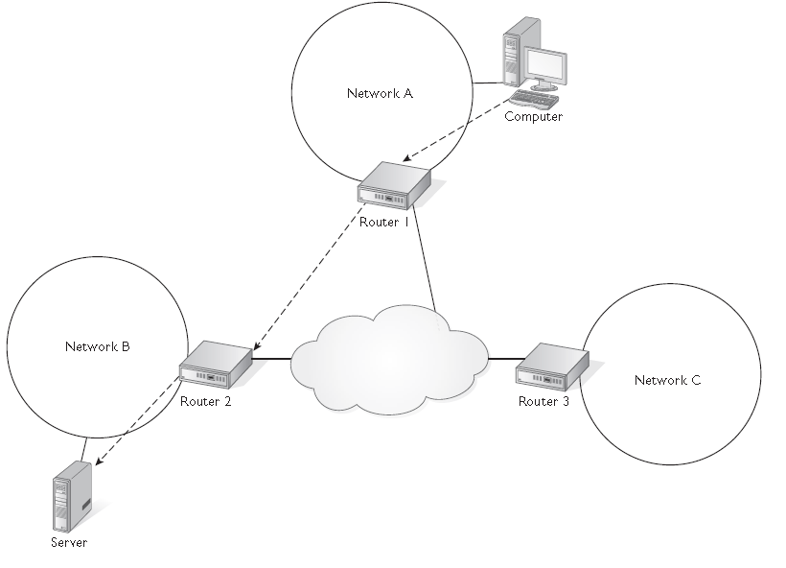
III. Connectivity Devices
E. Router
Routers use a routing table to determine how to reach a system on a destination network.
In the figure, if a computer on Network A wants to send data to a computer on Network B, it must leave Network A by means of Router 1, and then Router 1 sends the data to Router 2 which is responsible to send the data to the destination computer.

Slide 28
Now, you are okay with the basics of network hardware …
Our next lesson is about the network software ☺

Slide 29
Research Activity
Identify and describe the functionality of some more network connectivity devices other than those covered within this chapter.
What is meant by the “collision domain” and the “broadcast domain”. Differentiate between the hub, bridge, switch, and router, in terms of the collision and the broadcast domains.
Explain the difference between the three modes of transmission: simplex, half-duplex and full-duplex.

